Slide 1
What is enterprise Architecture?

Slide 2
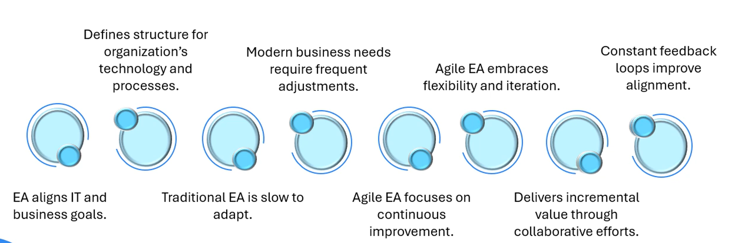
What is enterprise Architecture?

Slide 3
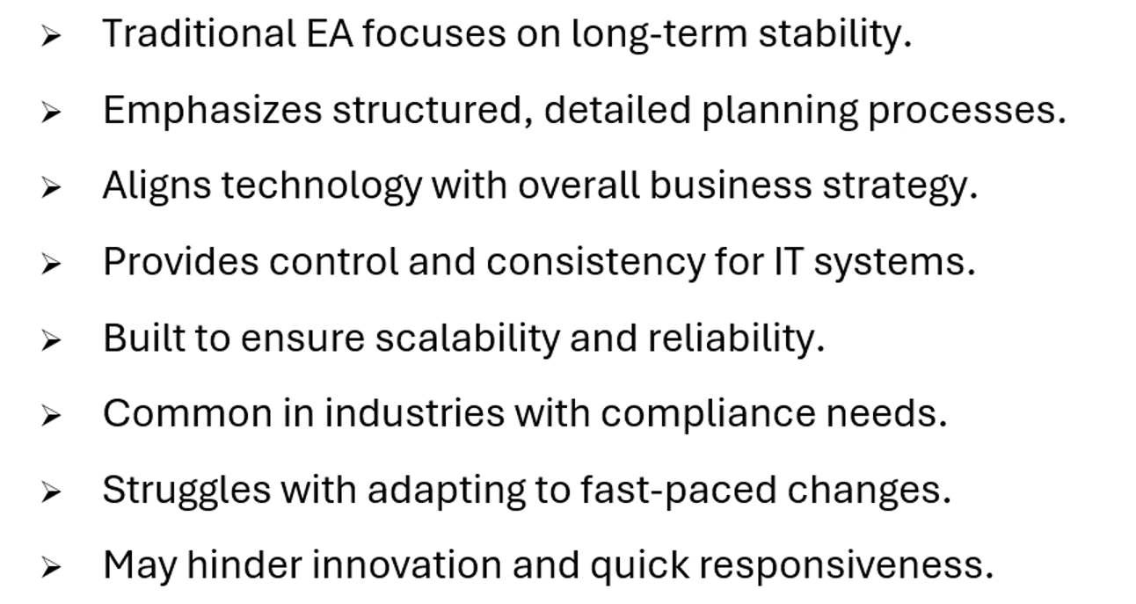
Overview Of Traditional Enterprise Architecture And Its Purpose

Slide 4
Thank you

